Slide 1

Survive the Jungle
An AAA RPG game based on Artificial Intelligence
TNP-GAmers

Slide 2
Every game is an opportunity to measure yourself against your own potential.
- Bud Wilkinson

Slide 3
What are AAA-RPG games?
AAA RPG games are high-budget, top-tier role-playing games developed by major studios. Known for their exceptional production values, intricate narratives, and expansive open worlds, examples include "The Elder Scrolls," "The Witcher," and "Final Fantasy" series. They represent a pinnacle of gaming quality and often require substantial time and resources to develop.
"AAA" usually stands for "Triple-A," indicating high quality and significant financial investment. "RPG" stands for "Role-Playing Game." So, "AAA RPG" essentially refers to a high-budget, top-tier role-playing game with exceptional production values.

Slide 4


Slide 5
About Survive
It is a part of an AAA RPG game based on the player’s survival skills. The player has to hide from an AI-based enemy which will try to find the player over time. This AI enemy is programmed in such a way that it will continuously roam around the map, and once detects the player, it will follow it till the player is not captured.

Slide 6
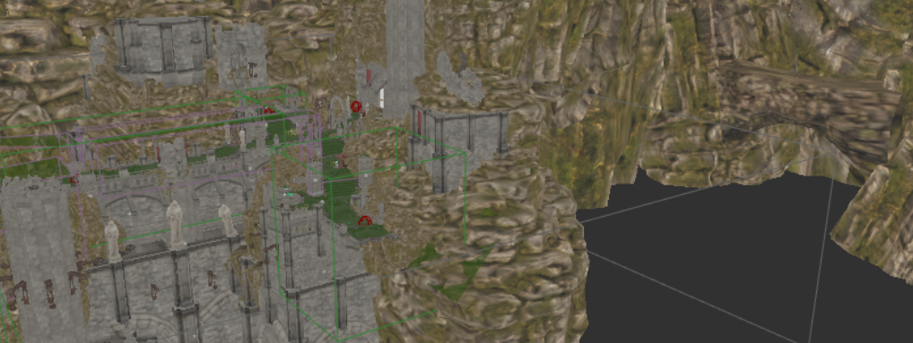
Map of the game
This map contains more than 150 meshes all around the area.

Slide 7
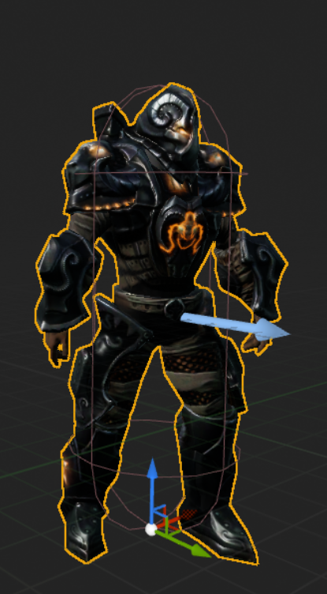
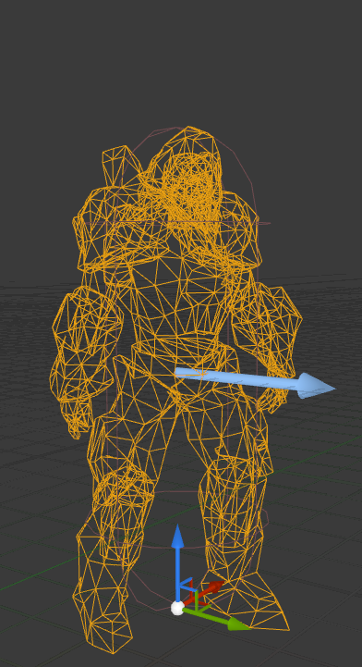
This is the model of the AI-based enemy. The first model is what the user will see, whereas the second one is the wireframe model.

Slide 8
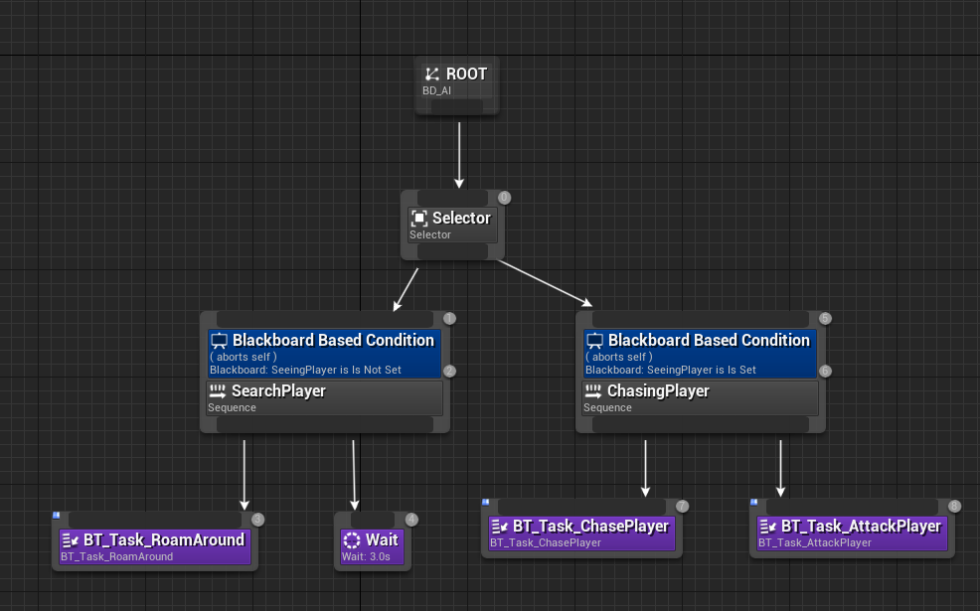
The Blueprint of AI Enemy

Slide 9
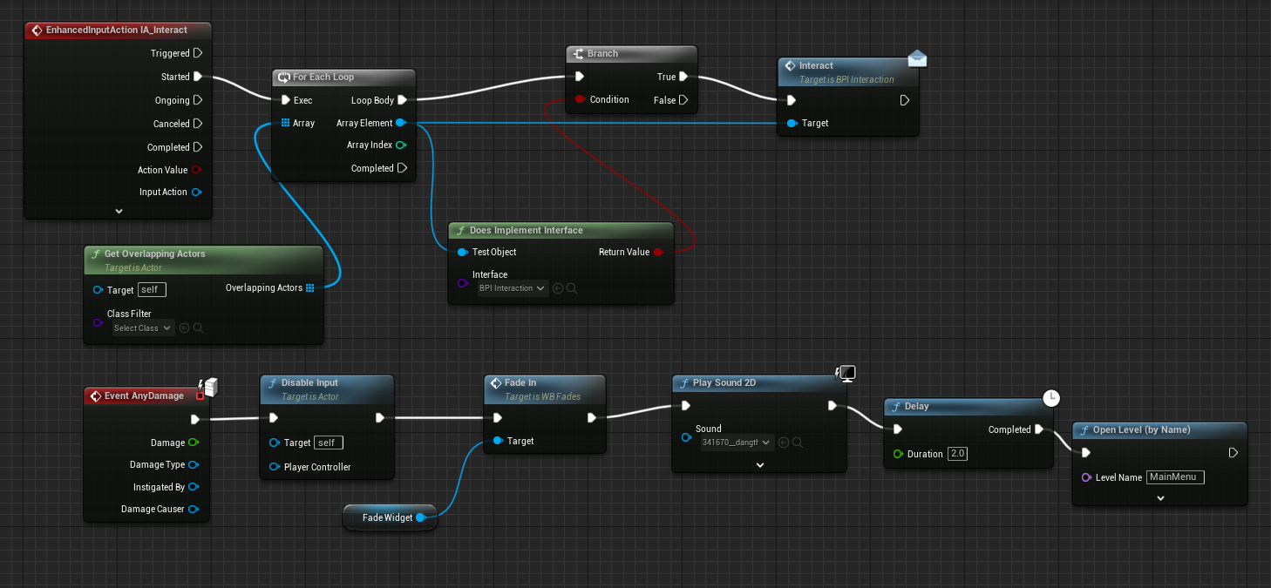
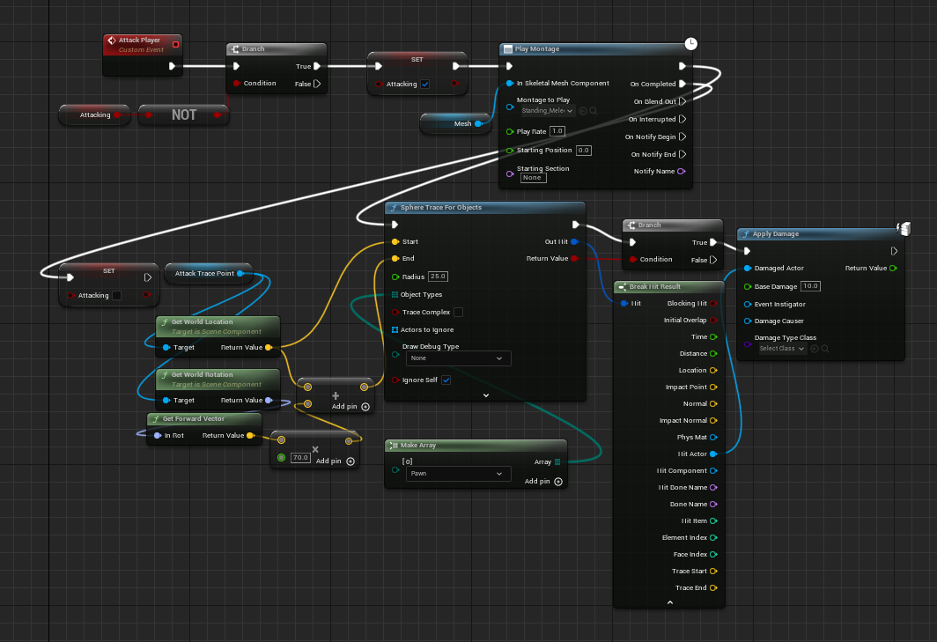
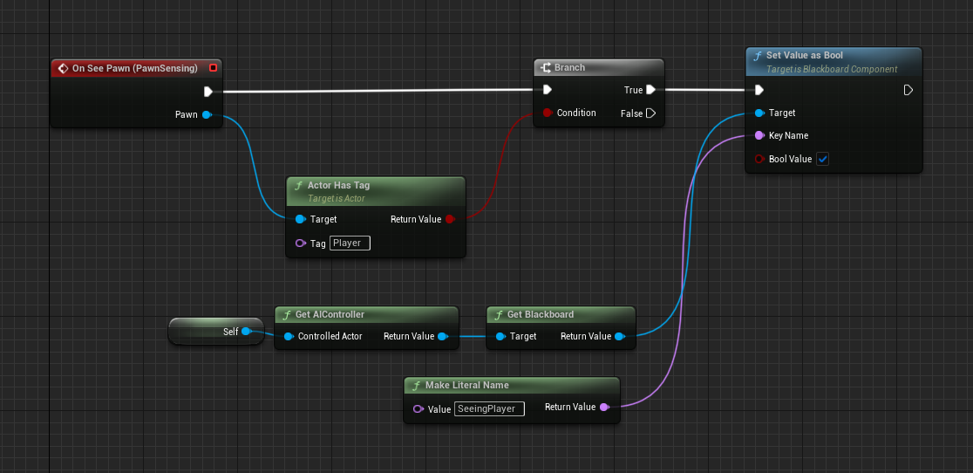
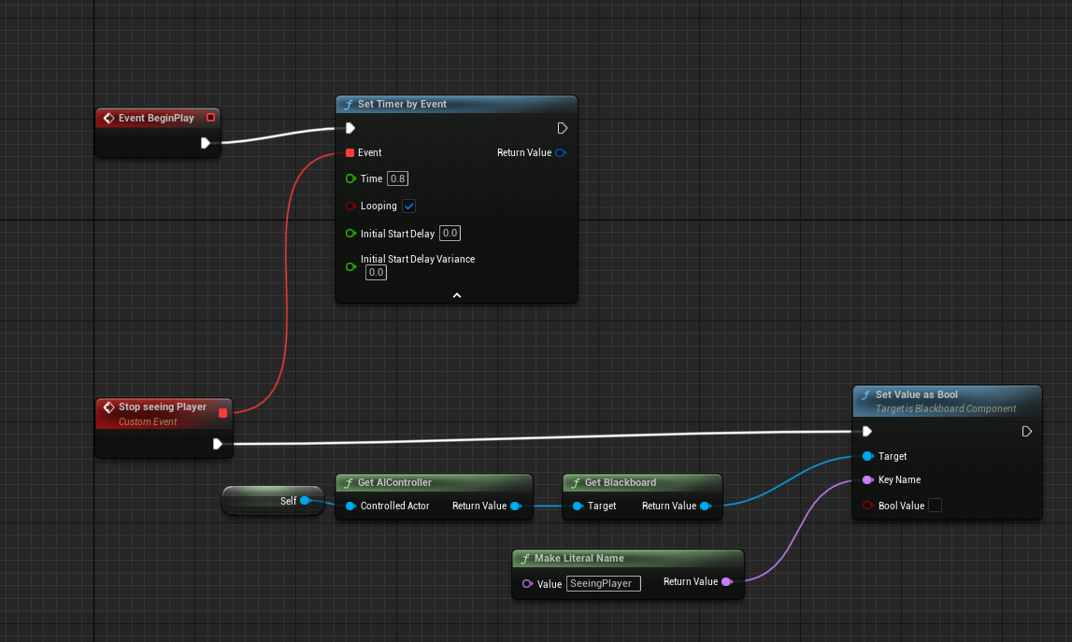
Blueprints of different actions of characters

Slide 10
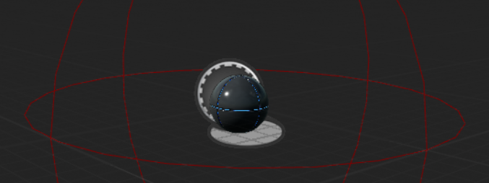
The Orbs that needs to be collected.
The red sphere can be described as an area where the player has to enter to collect the orb. This sphere works on collision.

Slide 11
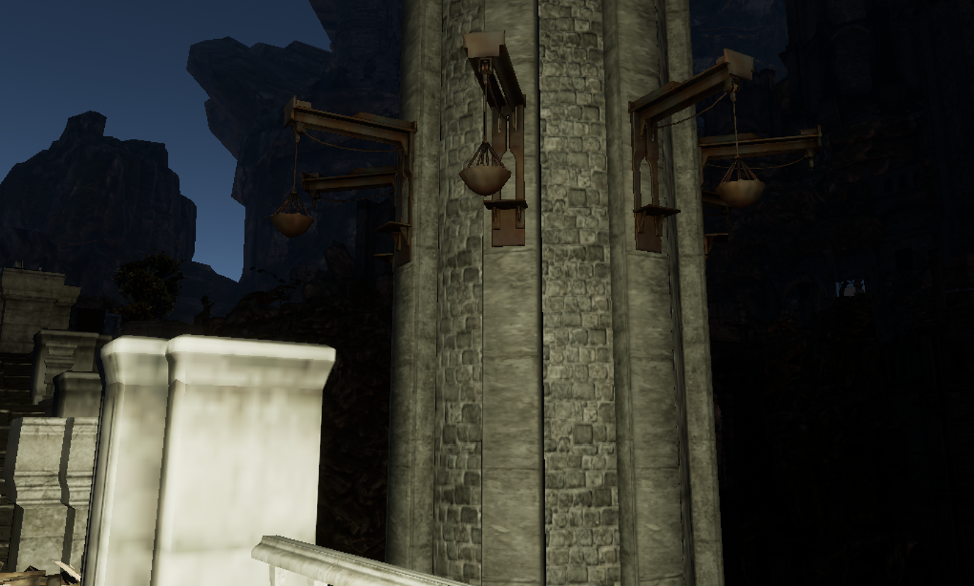
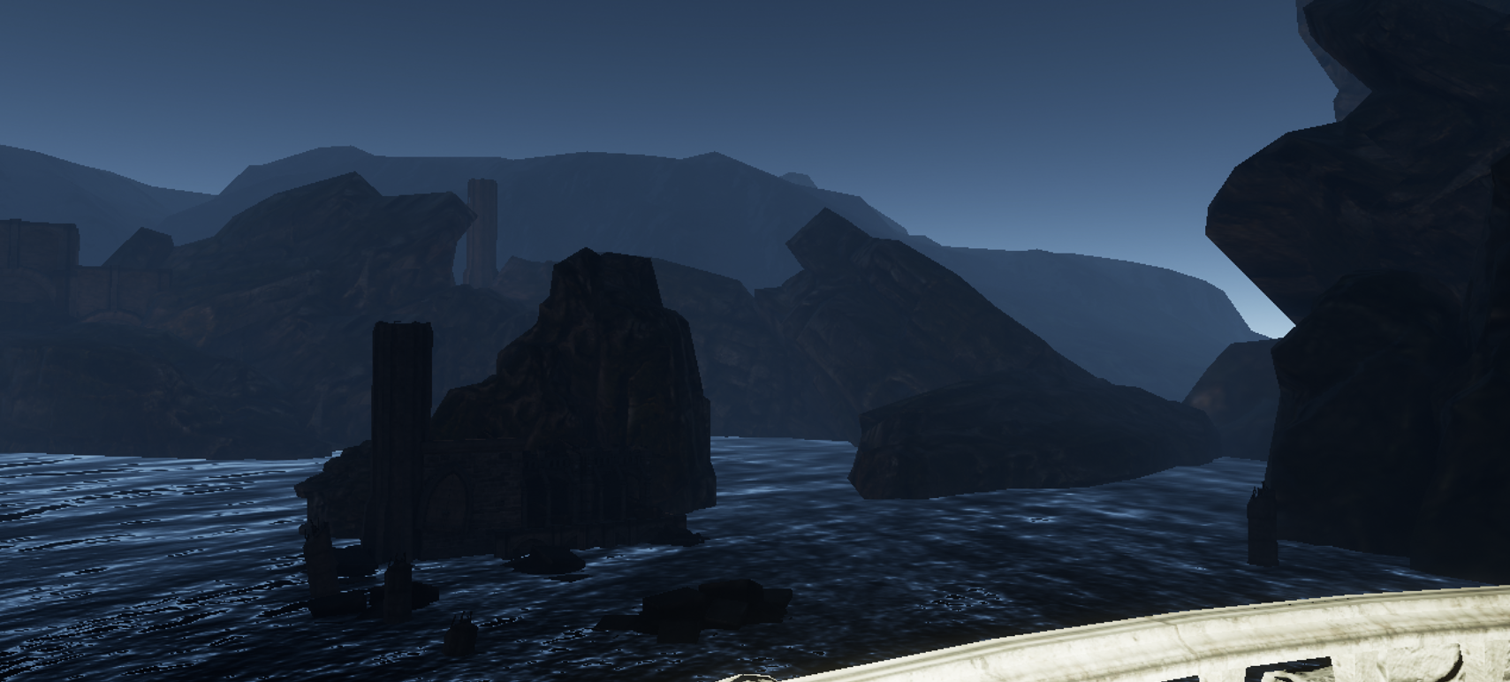
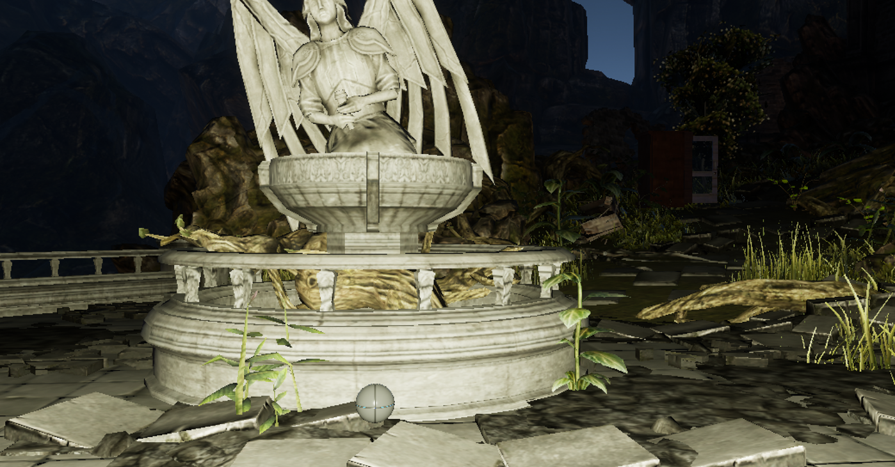
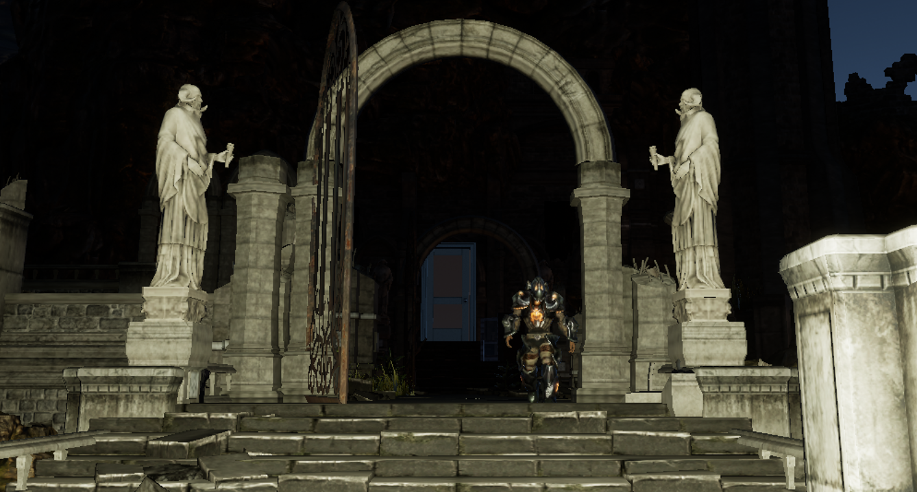
Scenes from the game

Slide 12
Thank you

